Slide 1

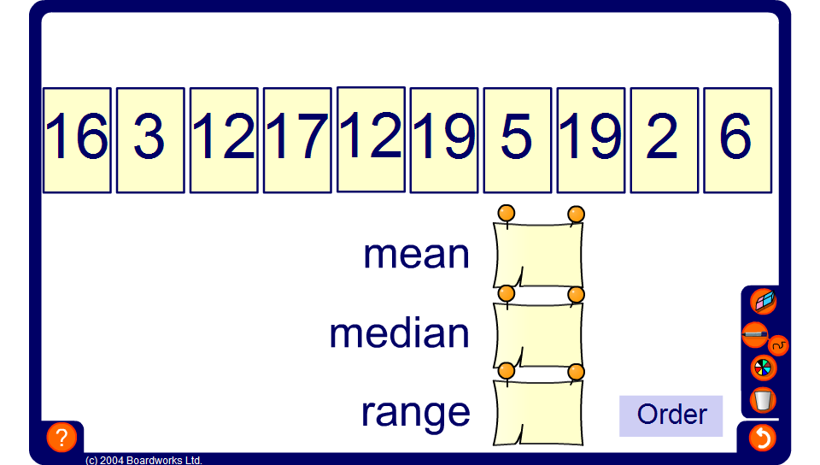


Find the median
Notes:
Encourage pupils to calculate the median themselves. After that let them check their results with the correct value calculated by the activity.

